Slide 1
What is Power BI?
Topic A

Slide 2




What is Microsoft Power BI? - Link
At its heart, MS Power BI is a data visualization tool.
The goal is to create visual reports that can analyze complex data.

Slide 3
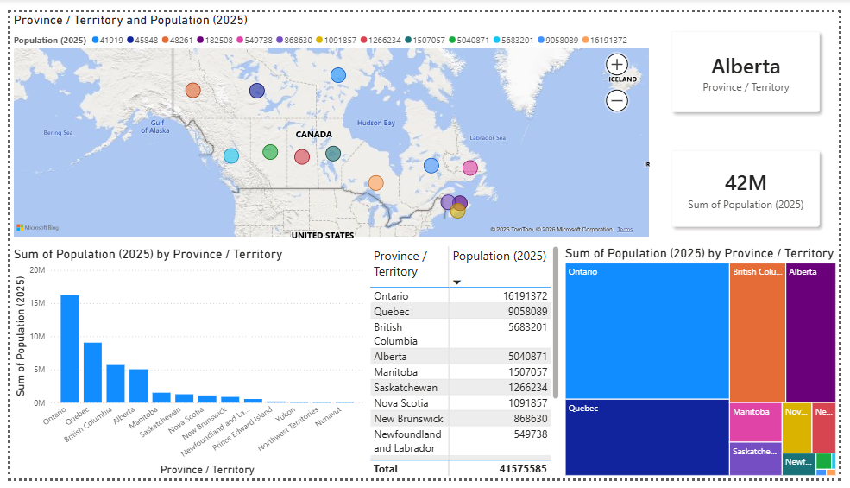
Data Visualization
Map
Cards
Tree map/Slicers
Chart
Table
Notes:
Visuals including but not limited to:
Maps, Tables, Graphs & Charts

Slide 4
Workflow of how it works
Connect/Import from a data source
[If Needed] Transform the data via Power Query
Analyze the data
Create tables/matrixes/columns/measures to answer business questions
Create visualizations & reports
Upload/Share Across Company

Slide 5
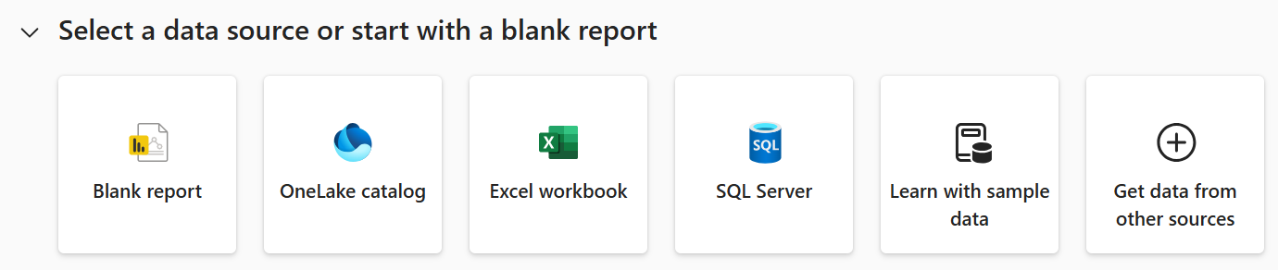
Connecting to Data Sources in Power BI - Link
In Power BI, data can be pulled from a database or an online portal.
According to this article:
"You can use hundreds of different data sources with Power BI.
The data must be in a format consumable by the Power BI service."
Other data sources can include:
  - Files (e.g. Text, CSV, Excel, Power BI Desktop files).
  - SaaS Cloud solutions (e.g., Salesforce, Google Analytics, Marketo, etc.)
  - Internal organizational and/or external data

Slide 6
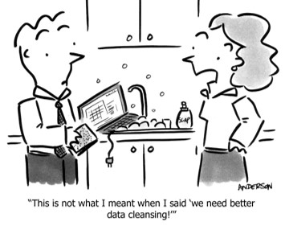
Prioritize Data Quality Over Data Sources
The main priority is whether the imported data is ‘clean’,
not where it comes from.
Make sure that imported data is:
  Complete - No crucial missing info/data
  Structured -
    Columns have clear names and a consistent,
    uniform format e.g. only names should appear in a ‘First Name’ column.
  Correct - No errors/wrong values/typos/duplicates
  Final Note: It’s assumed that imported data IS ready for analysis.

Slide 7


MS Excel vs MS Power BI
Great for manual data entry
Easy to update cell data manually or via formulas
Helpful for quick analysis (Ctrl + Q)
Good for creating some visualizations with charts, graphs, and PivotTables
  Although Excel can create one-off reports,
  Power BI does it better.
Ideal for interactive, scalable, and shareable reports
Robust features (e.g., AI) for analysis and visualization
  EX: Advanced filtering (e.g. filter by page)
Power BI is not meant for data entry
  We cannot directly add, delete, or edit rows
  Workarounds exist (Power Query) but require extra steps
Connect & combine over 100 data sources.

Slide 8
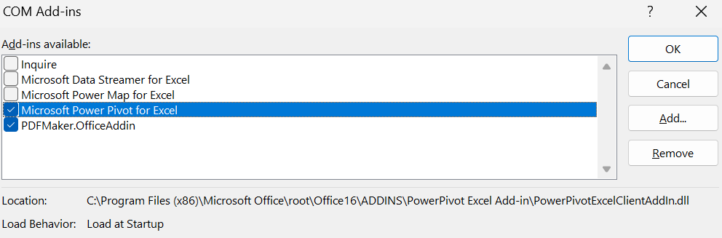
Power BI leverages the four Excel “Power Tools”
Excels ‘Power Tools’ are optional add-ins that extend Excel’s functionality.
They include:
Power Pivot
  Data Modeling
Power Query
  Data Transformation
Power Map
  Plots data on a map
There is an overlap between Excel & Power BI; being familiar with Excel can make Power BI easier to learn.

Slide 9
Components of Power BI Platform - Overview
Power BI is the platform/ecosystem
Desktop and Service are major components/applications within it
  Reports are files that contain visuals and can be made in both the browser and desktop.
Power BI Desktop
  Free Windows app (local software) used for creating reports and semantic models with visualizations.
Power BI Service (Online)
  A cloud-based platform that can be accessed by going to https://app.powerbi.com.
  Used to view, interact & share reports directly through the web browser.
  Used for creating dashboards from published reports and distributed to users/apps

Slide 10
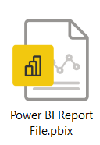
Component #1: Power BI Desktop (Local) Software - Link
Power BI Desktop is free! You do not need a paid license.
Great for creating and viewing reports; used for solo work.
Download the software either:
- By the app directly from the official MS Store at
https://go.microsoft.com/fwlink/?LinkId=2240819&clcid=0x409&culture=en-us&country=us
- Or from the official website at
https://www.microsoft.com/en-us/download/details.aspx?id=58494
Additional Info:
- No need to sign into Desktop app.
- Save and view your work locally on your PC as .PBIX files
Note that reports can be viewed locally. Other reports can be seen in Premium capacity.
- Premium Capacity -> A large server your company rents from Microsoft that lets Free license users view reports stored in it.

Slide 11
Component #2: Power BI Service (Online/For the Web)
The Power BI Service (cloud) is available at app.powerbi.com
Benefits:
  Reports can be published and shared with others.
    Users with a free license can still access reports, although with some limitations.
  Collaborate in workspaces (free users have access to only one workspace called "My Workspace").
  Power BI Service allows users to create and view dashboards (which we'll discuss later).
The Cloud = A broad concept.
Essentially is a bunch of remote servers (computers) that people can use & access over the internet, even though they’re owned by someone else.
SaaS (Software as a Service) = A Layer/Type of Cloud Computing
that rents software that runs on someone else’s cloud servers.
- You don’t install/maintain it yourself;
- You access it over the internet and pay for what you use, usually via a subscription.
(PaaS) - Where you can build and run code.

Slide 12
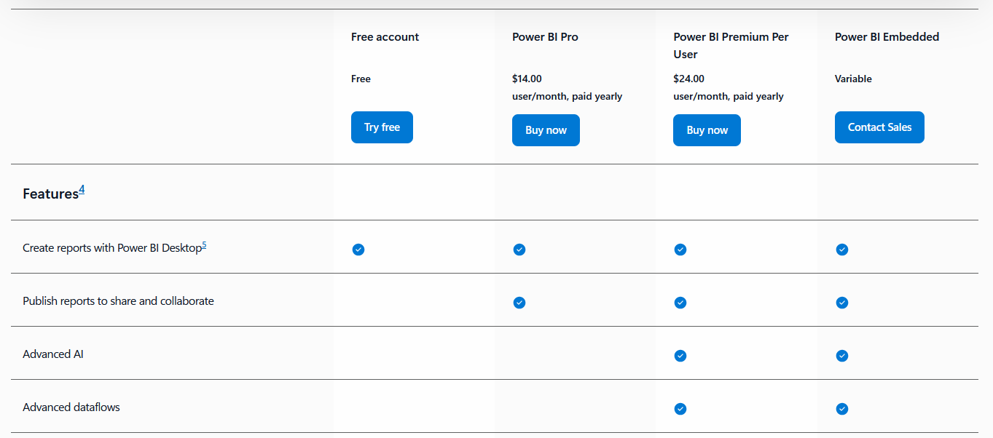
Microsoft Power BI Licensing - Link
Picture taken on June 9th, 2026

Slide 13
Summary
Choosing the right tool that connects to your organization’s data sources is important.
Choose Power BI Desktop to connect to data, prepare it for analysis, and create visualizations.
Choose Power BI Service(Online) when you need to share visualizations such as reports and dashboards.
Choose Microsoft Excel when you need to capture and store data in cross-tab format.

Slide 14

Now this is not the end.
It is not even the beginning of the end. But it is, perhaps, the end of the beginning.
- Winston Churchill

